Slide 1
Block diagrams

Slide 2


Transmitter (per Symbol)
Channel
(Signal)
Noise
Doppler Shift
$$e^{i 2π f_{d} t}$$
SF bits of Data
Modulate LoRa Symbol
Receiver (per Symbol)
Base Downchirp
$2^{SF}$ Point
FFT
SF bits of Data

Slide 3
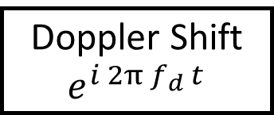
Transmitter (per Symbol)
X₀
X₁
…
X_{N-1}
Binary Data
QPSK MAP
Group N Samples
N Point Inverse FFT
x_{0,} x_{1,…}x_{N-1}
Prepend Cyclic Prefix
Channel (signal)
Noise
Doppler Shift
$$e^{i 2π f_{d} t}$$
Receiver (per Symbol)
X₀
X₁
…
X_{N-1}
Remove Cyclic Prefix
x_{0,} x_{1,…}x_{N-1}
N Point FFT
QPSK deMAP
Binary Data

